Slide 1
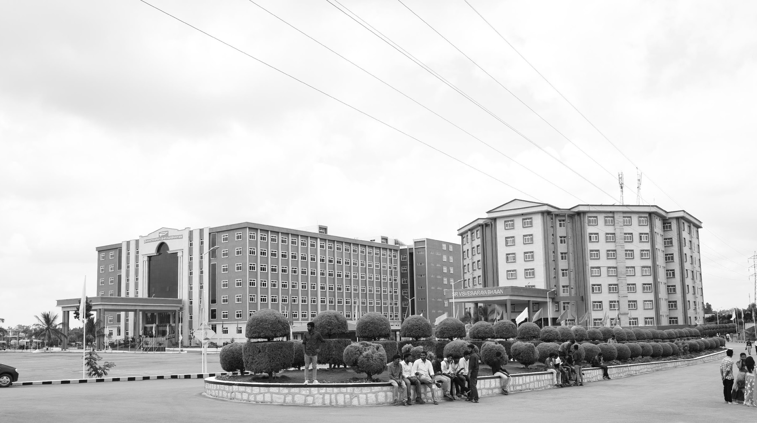
GITAM UNIVERSITY
Bengaluru Campus
Department of Electrical Electronics and Communication Engineering
AY 2021-25
Smart Energy Meter
Major Project
Project ID: Alpha 10(P2)
Project Team:
BU21EECE0100524 Sudeep B S
BU21EECE0100553 Lakshman B H
BU21EECE0100574 Darshan D M
Project Guide
Dr. P Sundararaman
www.gitamedu.com

Slide 2





Project Group – Details
Photo
Track
Roll No
Name
EECE Regular
BU21EECE0100524
Sudeep B S
EECE Regular
BU21EECE0100553
Lakshman B H
EECE Regular
BU21EECE0100574
Darshan D M

Slide 3
Introduction
In the era of smart technologies, energy management has become a critical component of modern infrastructure. The Smart Energy Meter Project aims to revolutionize the way energy consumption is monitored and it will send the electricity usage to utility providers and managed in residential and commercial settings. By integrating advanced metering infrastructure (AMI) with real-time data analytics, this project provides a comprehensive solution for efficient energy utilization and it will reduce human efforts. The smart energy meter is designed to record detailed information on electricity usage, enabling both consumers and utility providers to gain insights into consumption patterns. Equipped with IoT (Internet of Things) capabilities, the meter offers remote monitoring and control, ensuring seamless communication between the meter, consumers, and energy providers. The system employs secure data transmission protocols to guarantee the integrity and confidentiality of energy data. One of the standout features of the smart energy meter is its ability to support dynamic pricing models. By analysing consumption data in real-time, the meter can help users take advantage of off-peak rates and reduce their energy bills. The Smart Energy Meter Project also focuses on enhancing the resilience of the energy grid. By providing timely alerts and predictive maintenance insights, the system helps prevent outages and ensures a stable energy supply. Furthermore, the project incorporates user-friendly interfaces, making it easy for consumers to track their energy usage and implement energy-saving measures. Overall, the Smart Energy Meter Project represents a significant step towards a smarter, more efficient, and sustainable energy future. By empowering consumers with detailed energy insights and facilitating better energy management, this project has the potential to contribute significantly to global energy conservation efforts.

Slide 4
Objective and Goals
Objective
The primary goal of a smart energy meter for domestic usage is to provide real-time method for tracking, measuring, and controlling household energy consumption.
Real-Time Monitoring: Provides real-time data on electricity consumption to track usage.
Energy Efficiency: Helps optimize and reduce energy consumption by offering insights.
Accurate Billing: Ensures precise measurement of energy use for error-free billing.
Cost Savings: smart energy meters contribute to reducing energy bills and operational costs.
Goals
Main Goals:
Efficient Energy Management
Cost Savings
Energy Usage Transparency
Accurate Billing
Additional Goals:
Smart Home Integration:
Data Analytics and Insights:

Slide 5
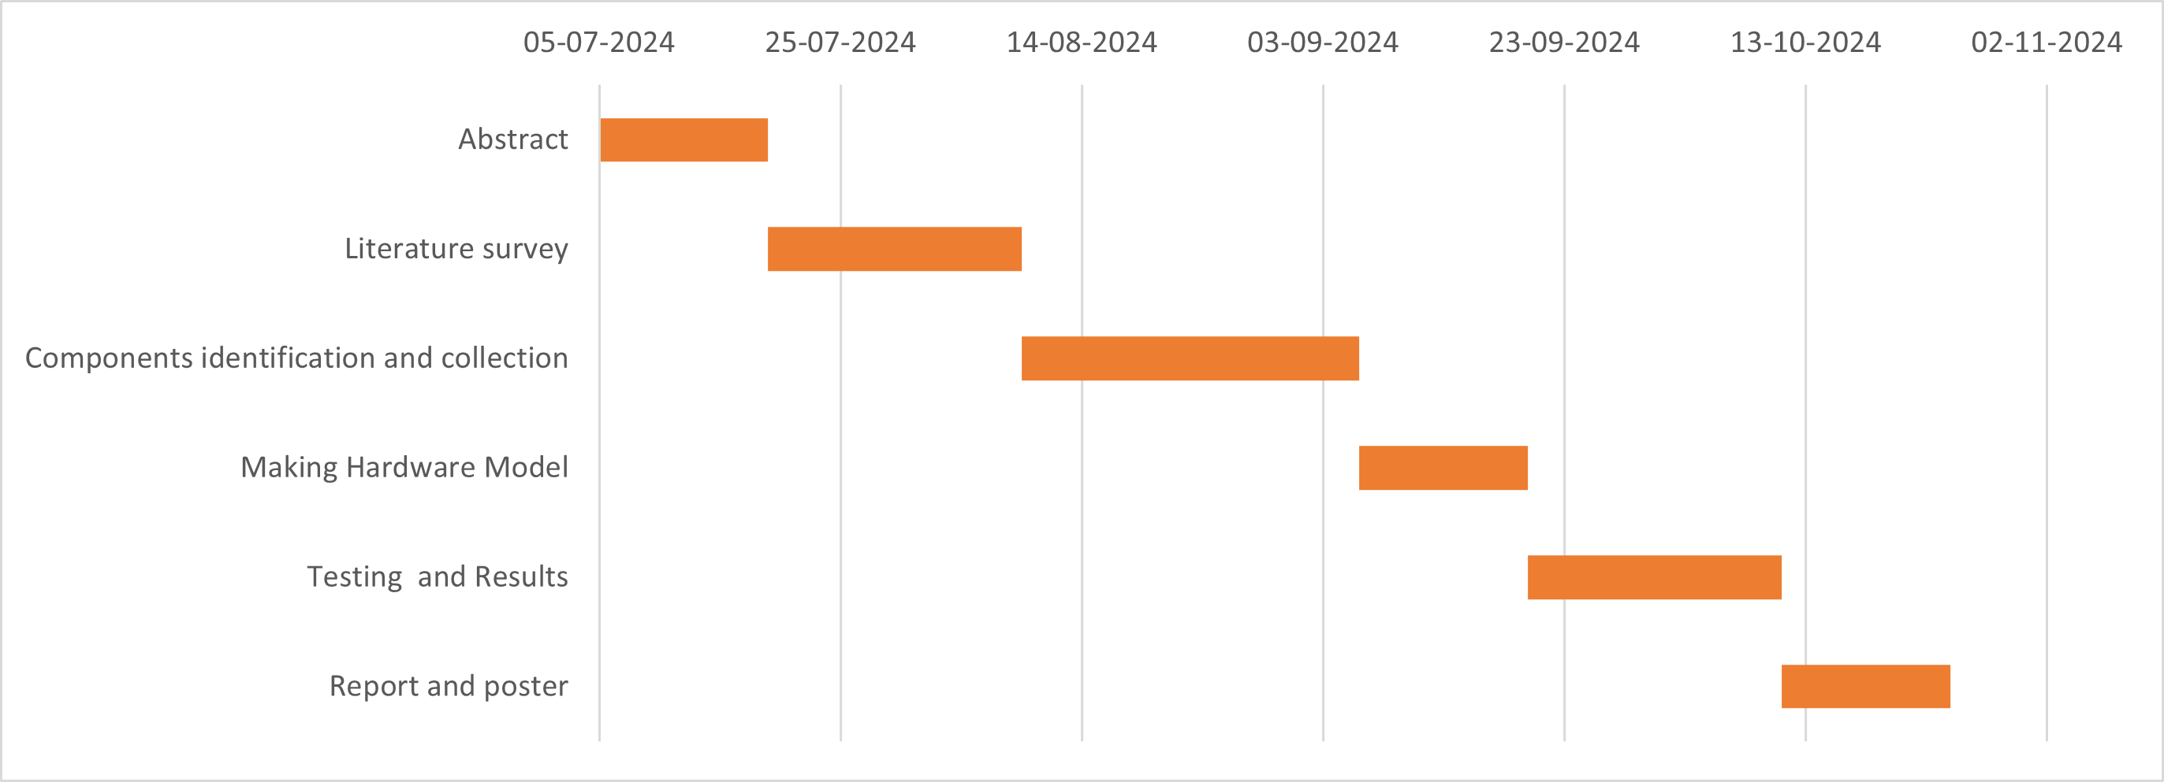
Project Plan

Slide 6
Literature Survey
SI NO | Title of the Paper (research paper) | Year | Author | Key Findings | Research gap
1. | DESIGN AND IMPLEMENTATION OF SMART ENERGY METER | 2022 | V. Preethi and G. Harish | Technology Utilization: The smart energy meter design leverages IoT technology, particularly using microcontrollers and wireless communication modules, to enable remote monitoring and management of energy consumption. Real-Time Monitoring: The system allows for real-time energy monitoring, providing both consumers and utility providers with accurate and up-to-date information about energy usage. Implementation Challenges: The document discusses various challenges encountered during the implementation, such as hardware-software integration, ensuring data security and privacy, and managing the cost of deploying such systems on a large scale. | Cost Concerns: The initial cost of deploying smart meters, including the cost of hardware, installation, and maintenance, is identified as a significant barrier, especially in regions with limited financial resources. Data Management and Security: The document points out the need for improved data management practices and enhanced security measures to protect the large volumes of data generated by smart meters from cyber threats.

Slide 7
SI NO | Title of the Paper (conference paper) | Year | Author | Key Findings | Research gap
2. | ARDUINO BASED SMART ENERGY METER USING GSM | 2021 | Himanshu K. Patel and TanishMody | Objective of the Study: The primary aim of the project is to design and implement a smart energy meter that can monitor electricity usage and send real-time data to users through GSM technology. Functionality: The system allows for real-time monitoring of energy usage. The Arduino microcontroller reads data from the energy meter, and this data is transmitted to the user via SMS using the GSM module. User Notifications: The system is designed to notify users about their energy consumption through SMS. It includes notifications for high usage, helping users to manage their electricity consumption more effectively. | Advanced Features: The system primarily focuses on basic energy monitoring and SMS notifications. Advanced features like remote disconnection, integration with IoT platforms, or detailed energy consumption analytics are not explored. Energy Efficiency: While the project aims to monitor energy usage, it does not address how the system itself can be optimized for energy efficiency, especially in terms of the energy consumed by the GSM module and Arduino.

Slide 8
SI NO | Title of the Paper (research paper) | Year | Author | Key Findings | Research gap
3. | DESIGN, IMPLEMENTATIONAND DEPLOYMENT OF AN IOT BASED SMART ENERGY MANAGEMENT SYSTEM | 2019 | M. USMAN SALEEM , M. REHAN USMAN , AND MUSTAFA SHAKIR | System Architecture: The document details the design, implementation, and deployment of an IoT-based Smart Energy Management System (SEMS). The system architecture integrates various IoT devices, a central server, and a user interface to monitor and manage energy consumption. Technologies Used:The system employs IoT devices such as smart meters, temperature sensors, and actuators for data collection and control. It also uses cloud computing for data storage and processing, and a mobile application for user interaction. | Security and Privacy Concerns: Although the system involves the use of IoT devices and cloud computing, there is limited discussion on the security and privacy implications of the system. Cost-Benefit Analysis: The document does not provide a detailed cost-benefit analysis of the system. Future research could focus on the economic feasibility of deploying such systems on a larger scale, considering the costs of IoT devices, cloud services, and maintenance.

Slide 9
SI NO | Title of the Paper (conference paper) | Year | Author | Key Findings | Research gap
4. | DESIGN AND DEVELOPMENT OF AUTONOMOUS SMART ENERGY METER WITH REMOTE MANAGEMENT CONTROL | 2020 | Umayal Muthu V , Dr.A Shunmugalatha Kowsika, Balamurugan, Aravind D S and Shanmuga Sundarapandi B | Automation of Energy Metering: The proposed smart energy meter automates the traditional manual recording of energy consumption, significantly reducing human error and inefficiency in billing processes. Remote Monitoring and Control: The system allows users to monitor their energy consumption in real-time via a mobile app, enabling better management of energy usage and identification of high-consumption appliances . | Evaluation: There is a lack of empirical data on the long-term performance and reliability of the smart energy meter in diverse operational environments. Energy Sources: Future research could investigate how the smart energy meter can be integrated with renewable energy sources and smart home technologies for enhanced energy management.

Slide 10
SI NO | Title of the Paper (conference paper) | Year | Author | Key Findings | Research gap
5. | DESIGN AND OPERATION OF SMART ENERGY METER FOR EFFECTIVE ENERGY UTILIZATION IN SMART CITIES | 2023 | Qasim Mali, Aamir Zia, Rehan Ahmad, Muhammad Asim Butt and Zain Ahmad Javed | Real-Time Monitoring: The system allows for real-time data transmission between consumers and utility providers, enabling immediate access to energy consumption data, which can help users adjust their usage patterns. Reduction of Human Error: By automating the data collection and billing processes, the smart meter minimizes the potential for human error associated with traditional meter reading methods. User-Friendly Interface: The design incorporates a display unit that provides users with essential information about their energy consumption, improving user engagement and awareness. | Consumer Behavior Insights: The study does not explore how the introduction of smart meters influences consumer behavior in terms of energy usage and payment patterns. Data Privacy and Security: While the paper mentions security features, it does not thoroughly examine the implications of data privacy concerns related to the collection and transmission of user consumption data.

Slide 11
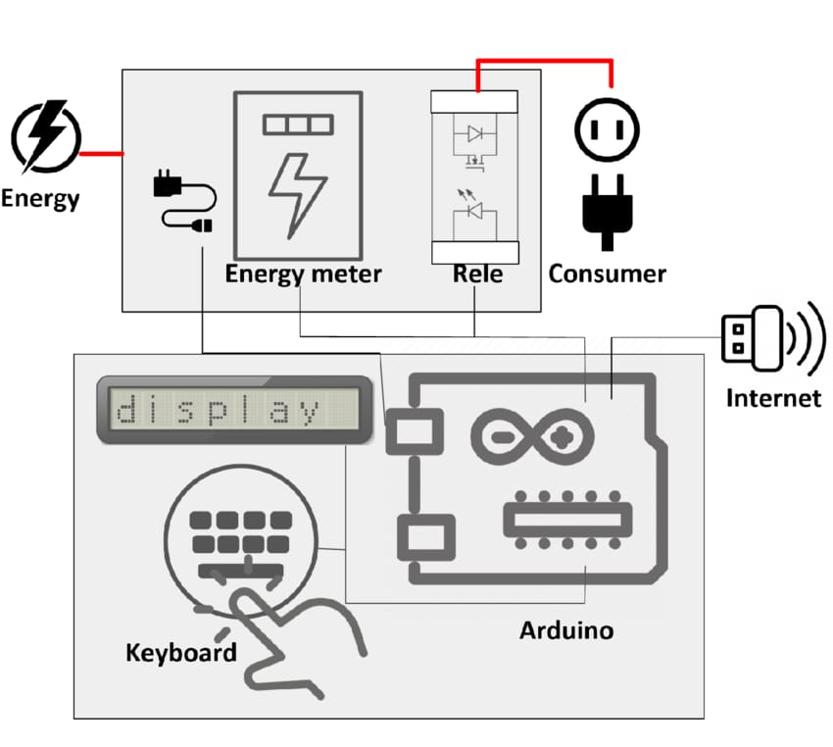
The Proposed Architecture
Referal Block Diagram

Slide 12
Conclusion
The literature survey on smart energy meters reveals significant advancements in energy management, driven by the integration of digital technologies. Various studies highlight the benefits of smart meters, including real-time data acquisition, improved billing accuracy, and enhanced energy conservation efforts. Furthermore, smart meters are seen as key enablers of smart grid infrastructure, facilitating better demand-response systems and allowing for more efficient load management. However, challenges such as data privacy, security.

Slide 13

THANK YOU

